Slide 1
Internet and Web Technology ICT- 2205 Lecture - 2
Presented By:
Mehrin Anannya
Lecturer
Institute of Information Technology
Jahangirnagar University.

Slide 2
Contents
Client-Server Architecture
How Do Web Browsers and Web Servers Fit the Client-Server Model?
How Do Web Browsers and Web Servers Communicate?
Web Protocols and Layered Communication Architectures
Web Addresses and Address Resolution via DNS
URLs, URNs, and URIs

Slide 3
Client-Server Architecture
The client-server architecture is one approach to communicate between two software applications that usually reside on physically distinct machines.
In typical client-server communication a client machine first sends a request to a server machine. The server then either honors the request by returning to the client whatever was requested, or returns an error that indicates why the request could not be honored.
At least this is the ideal response, and when an error is returned it is up to the software on the client side to decide what happens next.

Slide 4

Client Server Architecture (cont.)

Slide 5
How Do Web Browsers and Web Servers Communicate?
Web Protocols and Layered Communication Architectures
Web Addresses and Address Resolution via DNS
URLs, URNs, and URIs

Slide 6
Web Protocols and Layered Communication Architectures
Communication Protocol
A communication protocol is simply an agreement by two or more parties about what rules will be followed when communications between or among the parties take place.
Humans use protocols all the time when communicating.

Slide 7
Web Protocols and Layered Communication Architectures
Web protocol
A web protocol is, similarly, an agreed-upon set of rules and data formats to be used when two or more computers or other devices, or application programs running on those machines, wish to communicate across the Internet, usually but not always on behalf of human users.
In any given communication it is likely that there will be several different protocols involved.

Slide 8
Web Protocols and Layered Communication Architectures
Common web protocols
There are many protocols in use on the web. Here is a very short list of some of the more common ones:
TCP/IP (Transmission Control Protocol/Internet Protocol), a two-part protocol that underlies pretty much everything that travels over the web. This is the low-level “lingua franca” of the World Wide Web. If TCP/IP went away tomorrow, the web would cease to exist.
UDP (User Datagram Protocol), another protocol that can also be used as the underlying transport protocol for information, and though it may be faster to use if you are moving large multimedia files it does not guarantee that all of the information will arrive safely.
HTTP (HyperText Transfer Protocol), the protocol that browsers use to send requests for information to servers and that a server uses to send the requested information back to a browser.

Slide 9
Web Protocols and Layered Communication Architectures
Common web protocols (cont.)
FTP (File Transfer Protocol), the protocol used to transfer files from one computer to another across the Internet.
TELNET (TELephone NETwork) and SSH (Secure SHell) are both protocols that can provide “terminal emulation” when used to connect, over the Internet, to a remote computer and log in to an account on that computer. TELNET has been around for many years, but its use is discouraged these days because of security concerns, in favor of SSH, which is a more secure protocol for the transfer of information.

Slide 10
Layered Communication Architecture
One difficulty with trying to understand how things happen on the web is that there are so many of these web protocols, and often it is not clear which ones are in play.
A second difficulty arises from the fact that all these protocols are just parts of a much “bigger picture”.
If the second application replies, the process is reversed. On each machine, the data passes through several communication “layers”. There are different models of these layers, including the seven-layer Open Systems Interconnect Model and the four-layer TCP/IP Model. Just as a letter being sent by regular mail needs to have the address of its destination affixed if it is not to go astray, so does a request for information sent from a browser out on the Internet need to supply the “address” of the recipient to which the request is being sent.

Slide 11
Web Addresses and Address Resolution via DNS
IP addresses
Every computer attached to the Internet has a unique IP address, which has the form a.b.c.d, where each of the values a, b, c, and d is a positive integer in the range 0..255, and the intervening periods are a required part of the syntax.
This allows for just over four billion different 32-bit addresses.
So, if we are not to exhaust our available supply of addresses, another scheme must eventually be implemented.
This is the IPv6 scheme which is currently under development and implementation, and which will provide more Internet addresses than we are ever likely to need.

Slide 12
Fully Qualified Domain Names
So, though a computer will find it very convenient to work with a numerical “address” like 123.234.235.236, humans prefer names to numbers since they are usually easier to remember. Thus a computer with the preceding address may also have a name, or, more accurately and completely, a Fully Qualified Domain Name (FQDN), which could be something of the form
myhost.mycompany.myregion.com (if it’s a commercial website), or
someschool.downyonder.edu (if it’s an educational site)

Slide 13
Host machines and domains
The characters following the last period of an FQDN indicate the largest “domain” to which that name belongs, and can be a country code, such as ca for Canada, or one of a small number of specific designations, such as .edu for an educational institution, .com for a commercial enterprise, .gov for a government, or .org for an organization of some kind.
The name at the left of the domain name is generally the name of the host machine, and as one proceeds from left to right through the domain name, the succeeding names represent larger and larger domains to which that host machine belongs.

Slide 14
The domain name system and domain name servers
Because humans tend to use FQDNs and computers will use the actual numerical IP address when communicating with one another, there has to be a system to convert addresses from one form to the other.
This is the Domain Name System (DNS), and the machines connected to the Internet that perform the service of “resolving” any FQDN to its corresponding IP address are called Domain Name Servers or simply “name servers”.
Although it is possible to use IP addresses directly when “surfing the Web”, few humans would do so, so this process of “address resolution” is a very important part of what goes on as part of the traffic over the web.

Slide 15
URLs, URNs, and URIs
Uniform Resource Locator (URL)
A URL is, as its name suggests, a uniform way of referring to the location of a web document.
Naturally, therefore, the fully qualified domain name of the host machine on which the resource is located forms an integral part of the URL for that resource.
However, it is not enough to know where the resource is located.
One must also know, and be able to specify, how the resource will be accessed.
After all, not every web “resource” is just a page to be displayed.
So, a URL quite often has the form scheme:address_of_resource in which scheme is, more often than not, the familiar http and address_of_resource itself has the following form: //FQDN/path_from_document_root/name_of_resource.

Slide 16
URLs, URNs, and URIs (cont.)
Uniform Resource Name (URN)
A URN is a name that has the same form as a URL, but may not identify an actual location on the Internet. So, a URN can be used to talk about something without implying its existence or indicating how to retrieve a particular resource referenced by the name.

Slide 17
URLs, URNs, and URIs (cont.)
Uniform Resource Identifier (URI)
A URI is a more general concept than either a URL or a URN. According to Wikipedia,1 the “contemporary” viewpoint is that URLs and URNs are both “context-dependent aspects of a URI and rarely need to be distinguished”. In fact, it is suggested in the same Wikipedia article that the term URL may be falling into disuse, since it is “rarely necessary to distinguish between URIs and URLs”, and the more “user-friendly” term web address is now more frequent in any case.

Slide 18
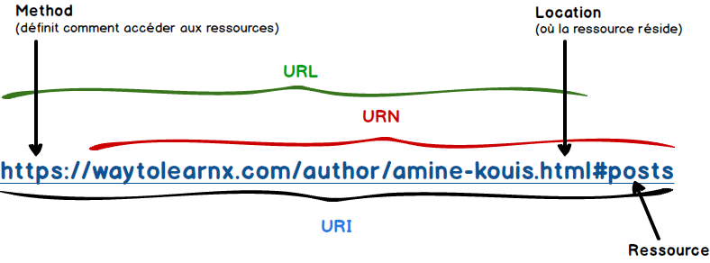
URLs, URNs, and URIs (cont.)

Slide 19
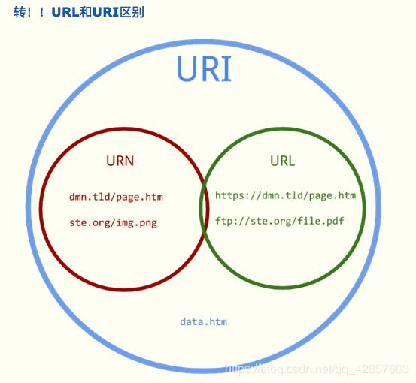
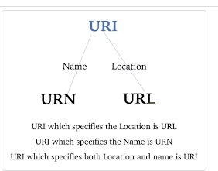
URLs, URNs, and URIs (cont.)

